Slide 1
Ready, Set, Experiment!
New Student Welcome and Orientation
2022
Kurt A. Engleka (Ingelkay, hard “g”) (he/him)
Assistant Director of Curriculum, BGS
Notes:
I will briefly talk to you today about the importance of the theory and practice guiding the design of experiments. This session represents our first steps in providing intellectual and physical resources that will help you plan and perform the best experiments you can, pursuing science at the highest level, that yield results that you and others can reliably build upon to discover something new. At least within the limits of time, money, energy, encouragement and thought at your disposal.
It is a little overwhelming to singularly stand here in front of all the talent in these seats. I sense your eagerness to be unleashed into the labs to conduct experiments. Think of how many different types of experiments and accompanying bytes of data you are about to bring into existence! Consider, though, that effective experiments, even seemingly simple ones, require a well-conceived plan PRIOR to the actual conducting of the experiment. How EXACTLY is the experiment performed? What EXACTLY is measured? What EXACTLY will you learn? A good experimentalist answers such questions BEFORE the actual conducting of the experiment. This is why we are introducing experimental design during orientation, so it is at the forefront before you begin experiments in the labs.
“Are you ready to perform experiments at Penn!” You are fortunate to be in an institution where you can do almost any experiment you want.
“What kind of data are you going to produce? Is the data from an experiment that was the best experiment you could perform under the circumstances? Is the data reproducible by you and others? Is it predictive so that you and others can build upon the results?”

Slide 2
Two Sides of Same Coin -either side you win-
Responsible Conduct of Research
(RCR)
Scientific Rigor and Reproducibility
(SRR)
Mandate that research be ethically sound and of rigorous methodological quality.

Slide 3
Goals for today
Develop an awareness of best scientific practices.
Introduce how you will develop experimental design skills with BGS
Notes:
For your use of best scientific practices during your training, research, and career.

Slide 4
A Good experimentalist…
Designs non-biased, effective experiments using a well-conceived plan
Produces results with
-high reproducibility
-high predictive value
Key concepts:
AWARENESS of different frameworks
hypothesis, model, question
Parameters defined PRIOR to experimentation
AVOID biases and inappropriate data filters

Slide 5
Experiments are Well-Conceived Plans
Experiment is: the whole
Experimental design
Clearly-defined hypothesis
including statistical procedures
Data collection
Analysis
Interpretation
Observe
Evaluate
Hypothesis
Generate
Hypothesis
Analyze
Data
Design
Experiment
Perform
Experiment

Slide 6
What’s in it for you?
Promotes experimental quality: learn something new every experiment
Facilitates reproducibility
Avoids bias
Saves time, resources, and avoids frustration
Notes:
Avoids frustration - mainly for you

Slide 7
experimental design within BGS
Self-
Learning
RCR and SRR
Training
Thesis Research
Classes
You as experimentalist
Other
Scientists
Lab
Rotations
Thesis
Defense
Preliminary
Exams
Notes:
For the remaining minutes, I would like to explain the myriad ways you will be trained and exposed to aspects of experimental design as part of your formal graduate education at Penn.
Critical Scientist
Lab Rotations/Modeling: Labs perform science differently. Scientists can be passionately critical of different approaches to a given problem.
Preliminary Exams: is a detailed plan of your thesis research
Training
Connectivity with Responsible Conduct of Research and Scientific Rigor and Reproducibility
Classes
Basis of knowledge
Exam Questions
Class Participation
Thesis Research
Repeating experiments. (yours and others)
Extending
Throughout all your training, you will have to filter and execute.
At the end of your grad school career: Have I done the experiment as well as I possibly could?

Slide 8
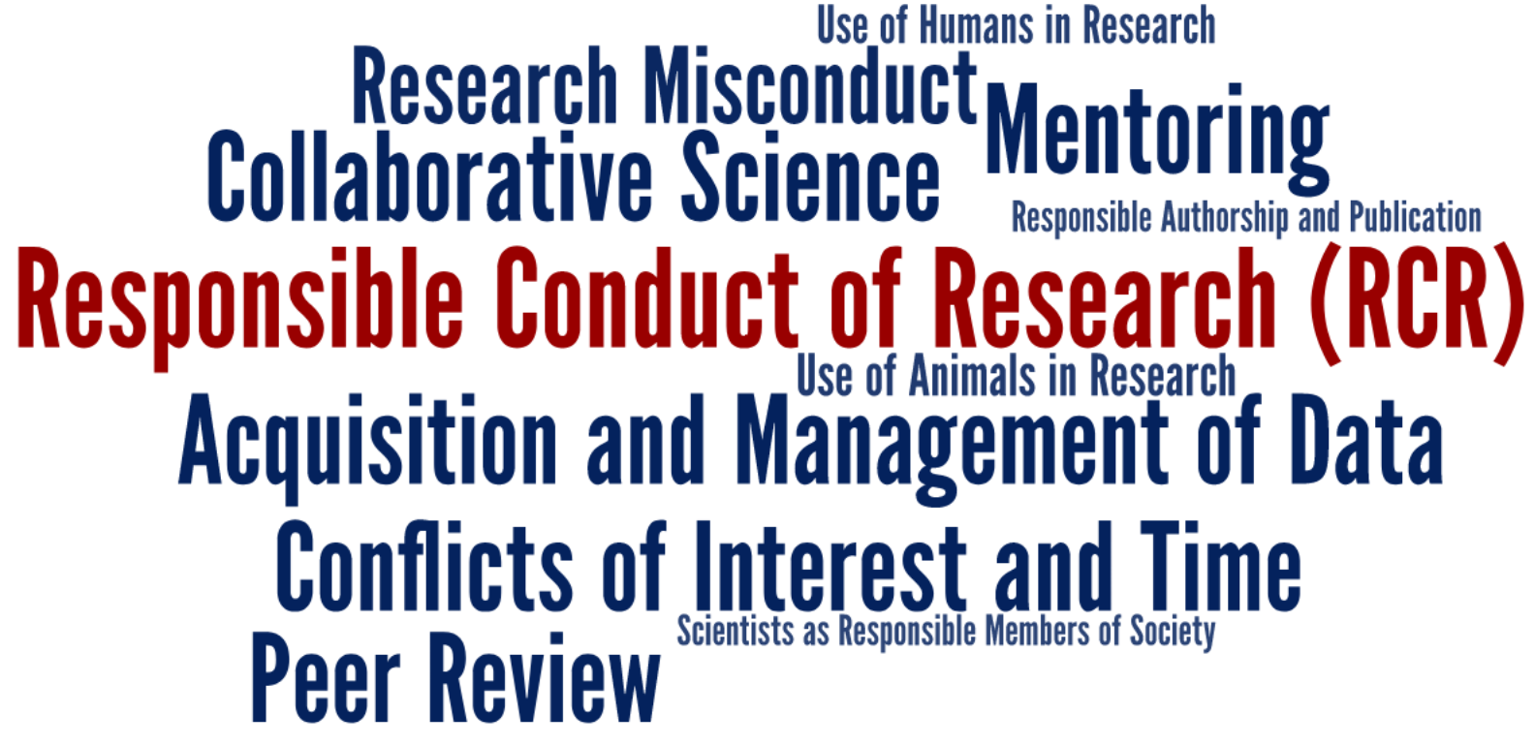
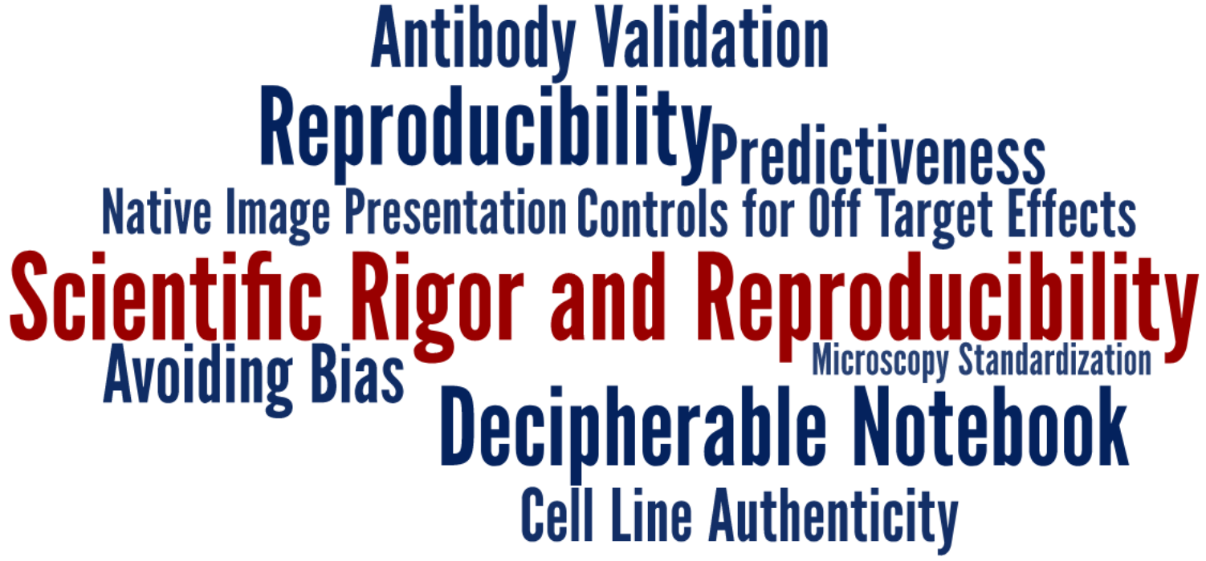
https://www.med.upenn.edu/bgs-rcr-exdes/
Notes:
Rigor, Reproduciblity & Transparency (R2T)

Slide 9
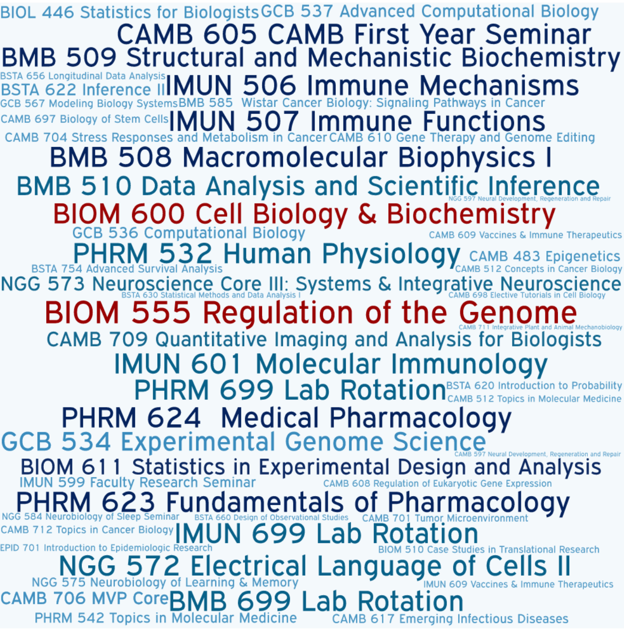
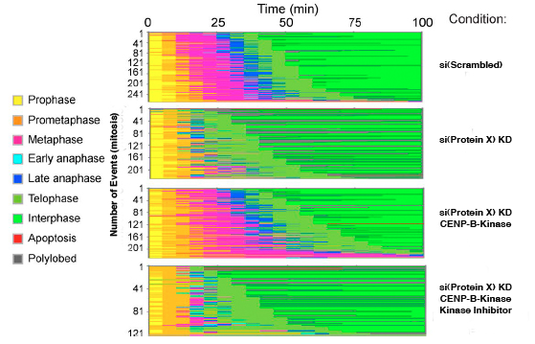
Courses
You will be asked about the experimental basis of knowledge!
Example Exam Question
Given an observation
describe/interpret data
formulate a hypothesis
describe experiments to test the hypothesis
describe controls
make predictions
summarize the results and analysis
make own conclusions
Notes:
In order to design an experiment that effectively adds to current knowledge, it is necessary to understand the current state of knowledge, as well as to have an idea of what the outcome of the experiment will add.

Slide 10
Experimental design…
requires a detailed plan!
How EXACTLY is the experiment performed?
What EXACTLY is measured?
What EXACTLY will you learn?
Details are critical and we want to hear them!
Notes:
Statements can be vague and provoke misunderstandings.
Example: is there a difference between “transcription factor X activates the expression of gene Y” and “transcription factor X promotes the expression of gene Y”?
Once the hypothesis (or model, question) is set, one must define in depth the path to get there
Need to think through the whole process on an end-to-end basis
Need to identify the novel parts, the hard parts
Need to identify the key milestones
This will include (at some level) questions such as:
What will we do?
Why will we do it?
Where will we do it?
Who will help us?
How will we do it?
How well do we have to do it?
When will we do it?
How many times will we do it?
How will you interpret the data?
What will happen if you see only a slight difference?
Statistics
Statisticians need this information up front
How to collect
What to control for
Number of data points
What things you will quantify?

Slide 11
Case studies
Controls and variables
Replication
Feasibility and risk
Idea Creation
Notes:
The case studies are starting points for discussion. There are no right/wrong answers.

Slide 12
Science Delivers! Perform Experiments!
Give the data the final word!
Notes:
Science is in the business of learning from its mistakes.
Science course-corrects as new insights are gained and as old theories are overturned. And despite the important debates about research integrity, reproducibility, robustness and the factors that can pull against good practice in these times of scarce funding, the system and the culture of science delivers. Knowledge is advanced, new medicines are made, human suffering is reduced.
Self-correcting
United in the spirit of inquiry
Importance of being open about methods, data and mistakes

Slide 13
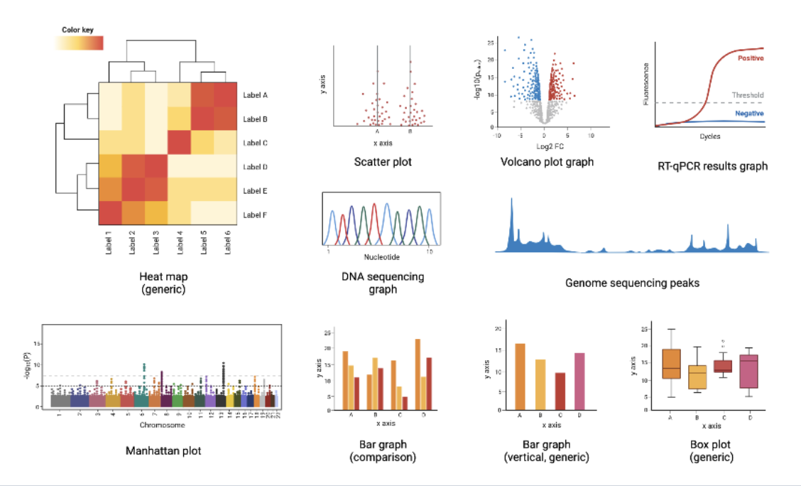
Small Groups
Groups 1 - 5 251 BRB
Groups 6 – 11 252 BRB
Groups 12-19 BRB Lob
Spillover BRB Lobby

Slide 15
The learner will be able to…
Identify independent, dependent and confounding variables in experiments
Describe the differences between technical and biological replicates and readily identify examples of each in experiments
Describe how elements of feasibility and risk inform decisions in prioritizing experiments
Describe how hypothesis generation involves creativity/imagination using a well-informed knowledge base and how the best hypotheses are testable and specific

Slide 16
Case Study: Controls & Variables
and Dependent variable
X causes Y.
Independent
Z
Confounding variable
Identify all potential variables that may exist and control for as many as possible.
Notes:
Independent variable = cause
Dependent variable = effect

Slide 17
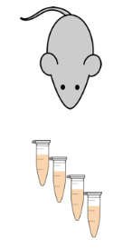
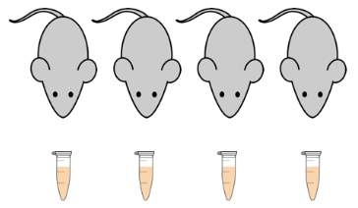
Case Study: Replication
Technical vs. Biological Replicates

Slide 18
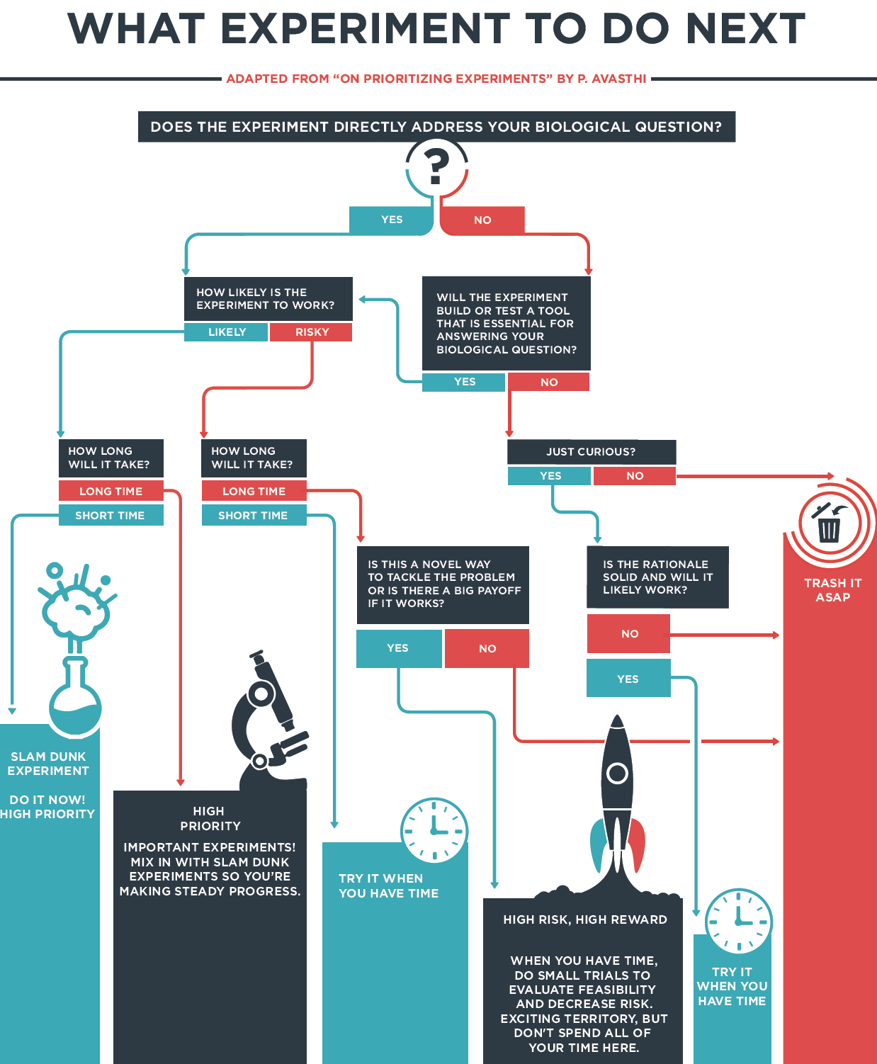
Case Study: FEASibility & RISK
What motivates your decision to perform an experiment?
Strategy to navigate through many choices
Notes:
Strategies to promote your ability to make efficient progress on your research project
Finding out as quickly as possible if your hypothesis is wrong
Break down most important questions into smaller, solvable questions!
Learn something from every experiment!
https://courses.ibiology.org/courses/course-v1:iBiology+LE+SP/about?utm_source=ActiveCampaign&utm_medium=email&utm_content=%22Let+s+Experiment%22+is+now+available+self-paced%2C+anytime%21&utm_campaign=Courses+list%3A+%22Let+s+Experiment%22+is+now+available+self-paced%2C+anytime%21
In the course (from the website):
Hear inspiring speakers share new perspectives about important, but sometimes lost, aspects of experimental design.
Learn how biological research really happens from real-world examples, and gain tips on how to navigate it.
Apply what you’re learning to your own research, and walk away with a solid plan for how to start and carry out your own experiments.

Slide 19
Case Study: Idea Creation
Generating
Ideas
Testing
Ideas

Slide 20
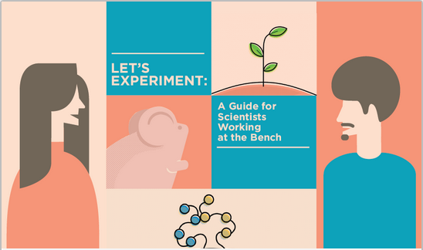
Resource
Free online course available self-paced, anytime
Tailored for students BEFORE stepping into the lab
https://courses.ibiology.org/courses

Slide 21
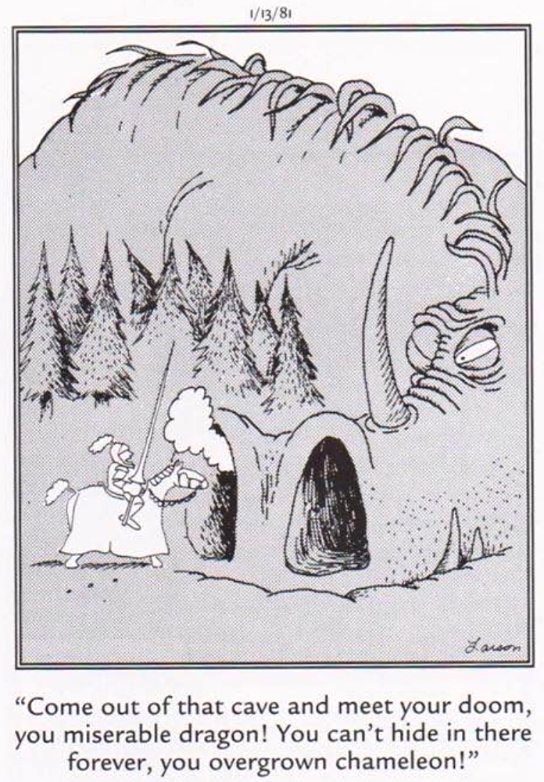
Be aware: Opportunities for deception are plentiful.
Your expectations can influence what you see.
It is easy to be fooled!
Good experimentalists are aware of these traps.
Far Side, Gary Larson

Slide 22
Small Groups
Fearing that he/she will be cold-called, the grad student glares at the professor in an audacious game of reverse psychology.
Lego Grad Student
https://brickademics.com

